Slide 1


Basic Details of the Team and Problem Statement
Ministry/Organization Name/Student Innovation:
AICTE, MIC-Student Innovation
PS Code: SIH1493
Problem Statement Title: Student Innovation
Team Name: Komet
Team Leader Name: Abhijit Patil
Institute Code (AISHE): U-0760
Institute Name: Indian Institute of Information Technology, Sri City, Chittoor
Theme Name: Heritage & Culture

Slide 2
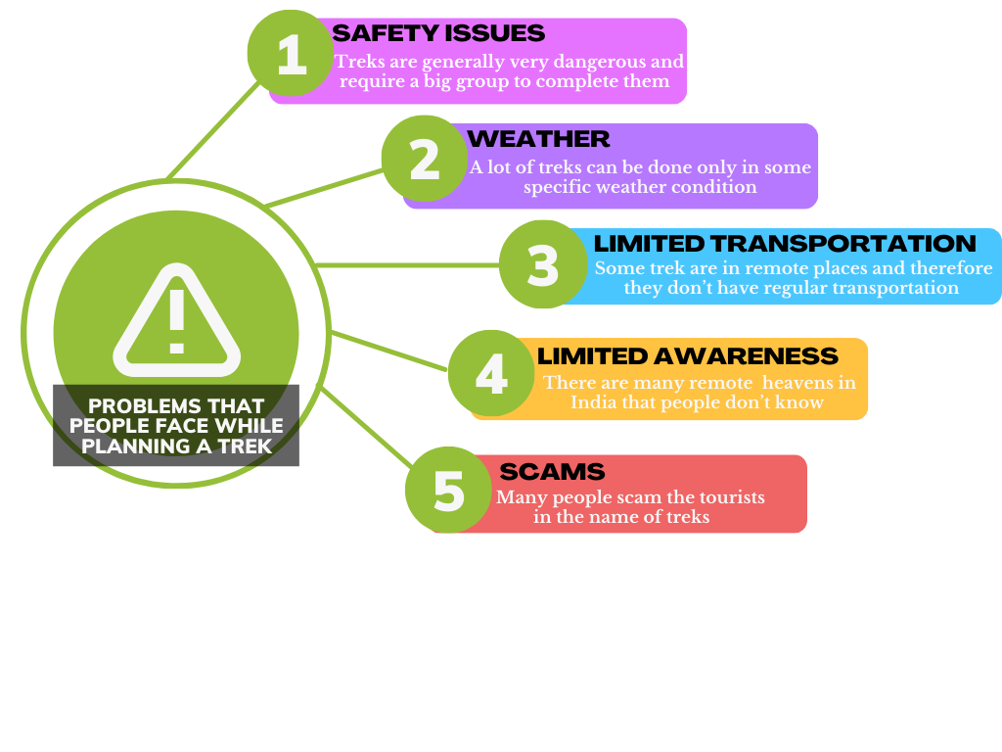

-- APPROACH --
• India is a very diverse country with a very rich heritage and culture
• But now-a-days due to globalization and foreign influence many Indians have forgotten their roots
• The key objective of this project is to put this incredible diversity and heritage to good use and help other fellow Indians benefit from it.
• A times of India study published in march 2019 says that almost 80% of all small-scale gathering in India are organised in malls or restaurant and we want to change that.
• But to change this first we will need to find out the reason behind why do people prefer malls and restaurants over treks to waterfalls or forts
Describe your Technology stack here:

Slide 3
--APP FEATURES--
PLANNING PAGE:
State-of-the-art planning AI that considers all the factors like:
weather, optimum time frame, trending locations, nearness,
minimum carbon footprint, .... To give you the best trip to go on.
HOME PAGE:
This page displays all the relevant trips happening near you which you
can join. This is powered by the AI algorithm which will consider data
like : following/followers ,preferences ,location.
PROFILE PAGE:
This page displays your interests , previous trips . It also
displays your followers/following .It is also a show case for your
achievements and collectables which indirectly conveys your
experience
HEAT MAP:
This show the most popular/visited locations on the
map in the form of a heat map
CARBON FOOTPRINT CALCULATOR:
This calculates the carbon footprint of the whole trip so that you can try to
minimize it in your next trip
AND MANY MORE….

Slide 4
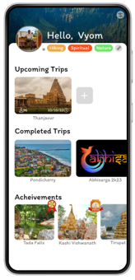
--DEPENDENCIES--
--TEAM MEMBER DETAILS--
Abhijit Patil (Leader) [abhijitchandrakant.p23@iiits.in]
B.tech /UG-1, ECE
Gaurav Gautam [gaurav.g23@iiits.in]
B.tech /UG-1, CSE
Sarayu Mallepaga [abhijitchandrakant.p23@iiits.in]
B.tech /UG-1, ECE
Vyom Nikhra [vyom.n23@iiits.in]
B.tech /UG-1, ECE
Vedant Kesarwani [abhijitchandrakant.p23@iiits.in]
B.tech /UG-1, ECE
Abhiraj Singh Chouhan[abhijitchandrakant.p23@iiits.in]
B.tech /UG-1, ECE

